Slide 1
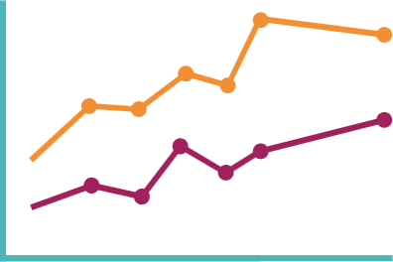
Main finding/Key message goes here, translated into plain English. Emphasize the important words.
Non-Cognitive Predictors of Student Success: A Predictive Validity Comparison Between Domestic and International Students
AMMO BAR
Delete this and replace it with Implications for
practice
policy
organizational/system leadership
You may also wish to include here or via QR code
Extra Graphs
Extra Correlation tables
Extra Figures
Extra nuance that you’re worried about leaving out
Title: Subtitle
PRESENTER:
Robeson, Paula
BACKGROUND: Who cares? Explain why this issue, your study or project matters to Children’s Healthcare Canada members, partners, and other child health stakeholders in the fastest, most brutal way possible (feel free to add graphics!).
METHODS
Collected [what] from [population]
Tested it with X process.
Illustrate your methods if you can.
Try a flowchart!
PATIENT PARTNERSHIP
Describe nature of involvement in research design, data collection, interpretation of findings,and/or articulation of implications
RESULTS
Graph/table with essential results only.
All the other correlations in the ammo bar.
Visualize your findings with an image, graphic, or a key figure.
Leeroy Jenkins, author2, author3, author4, author5, author6, author7, author42
Take a picture to download the full paper
(or direct them to your website, further resources, etc).
Notes:
Notes:
In Powerpoint, click View > Guides
Keep text within gutter guides.
Author list: Don’t split names onto two lines (e.g., “Jimmy [break] Smith”). If that happens, use a new line, unless you need the space. Bold the first names of anybody who’s presenting in person.
Intro/methods/result: Do not drop below font size 28, but if you have extra space, jack up the font size until the space is full.
Do not use color in the sidebars except in graphs/figures. It’ll pull attention from the center and slow interpretation for passersby.

Slide 2
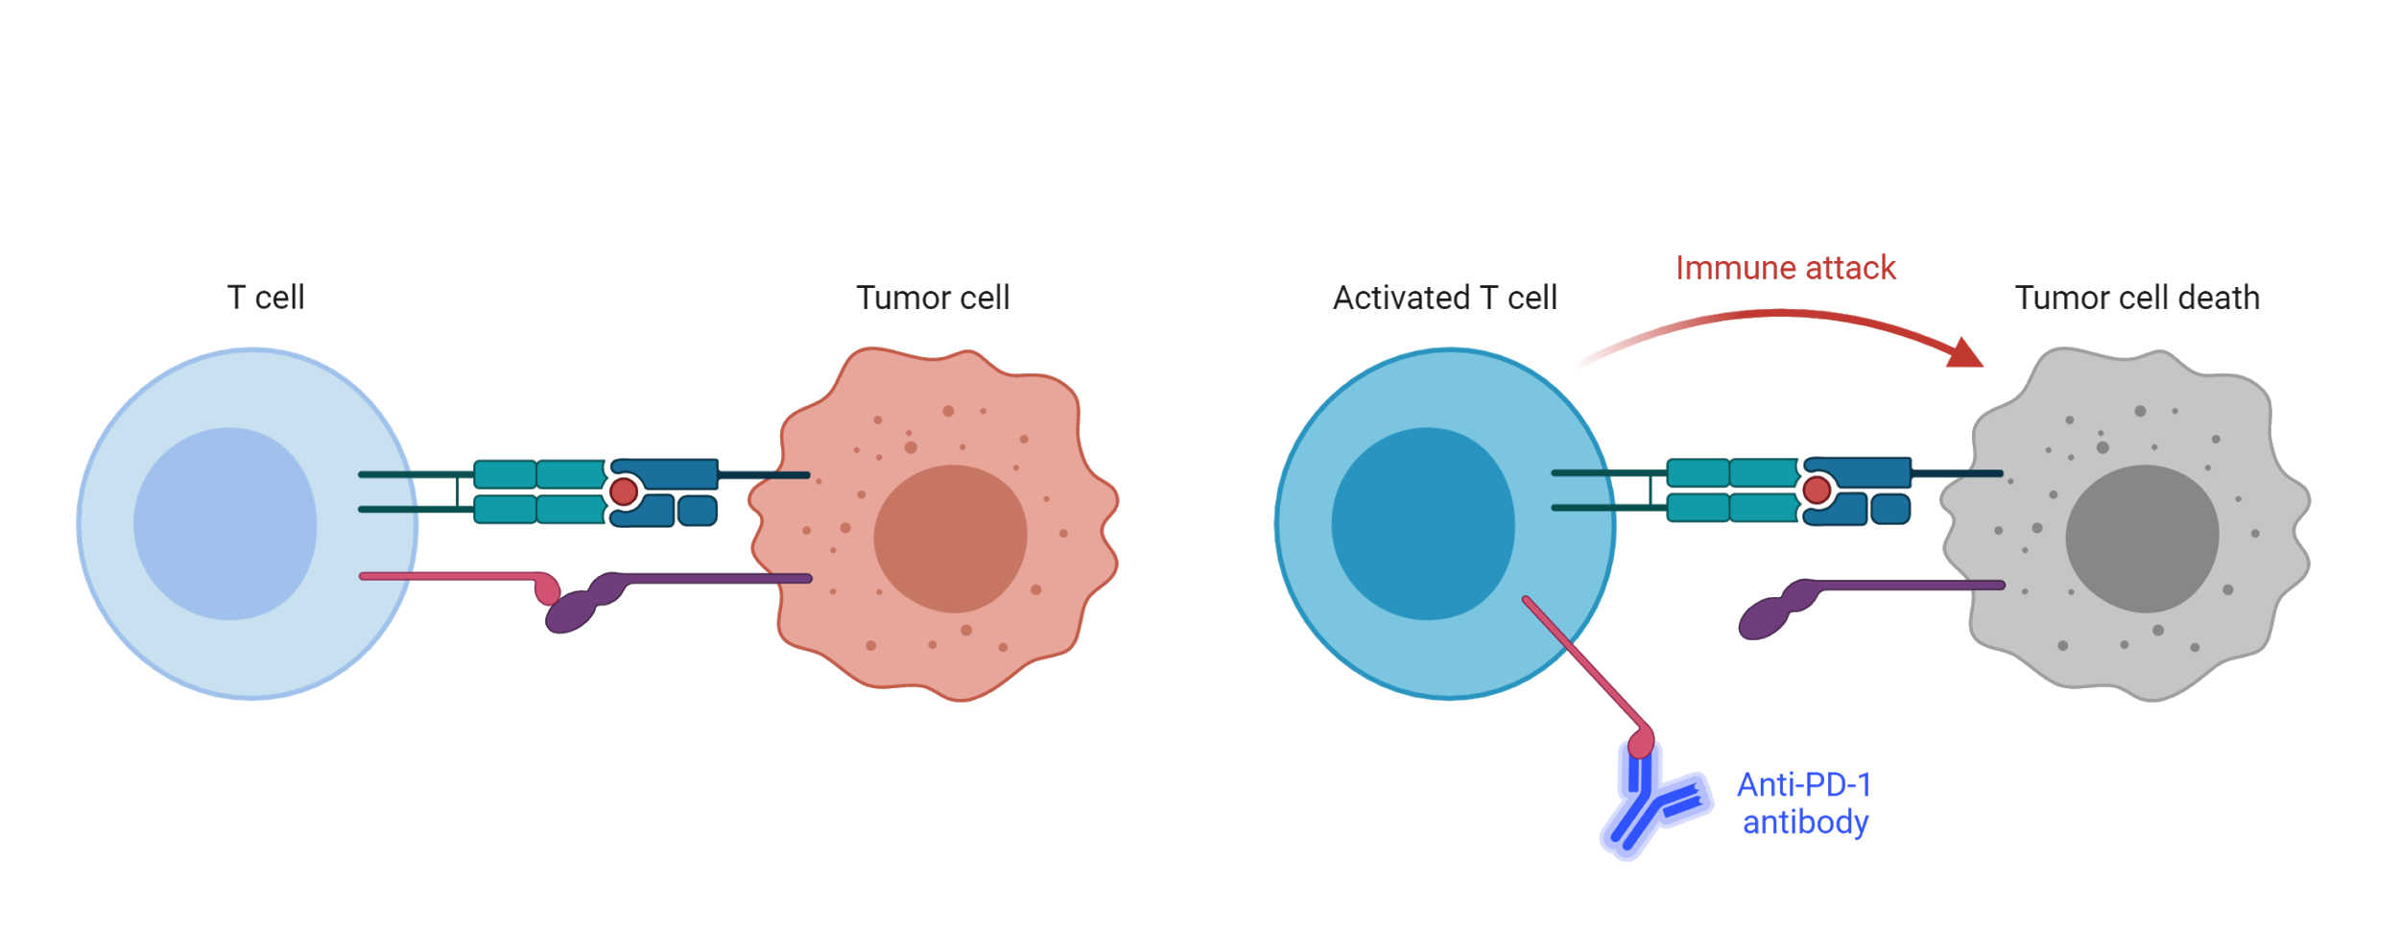
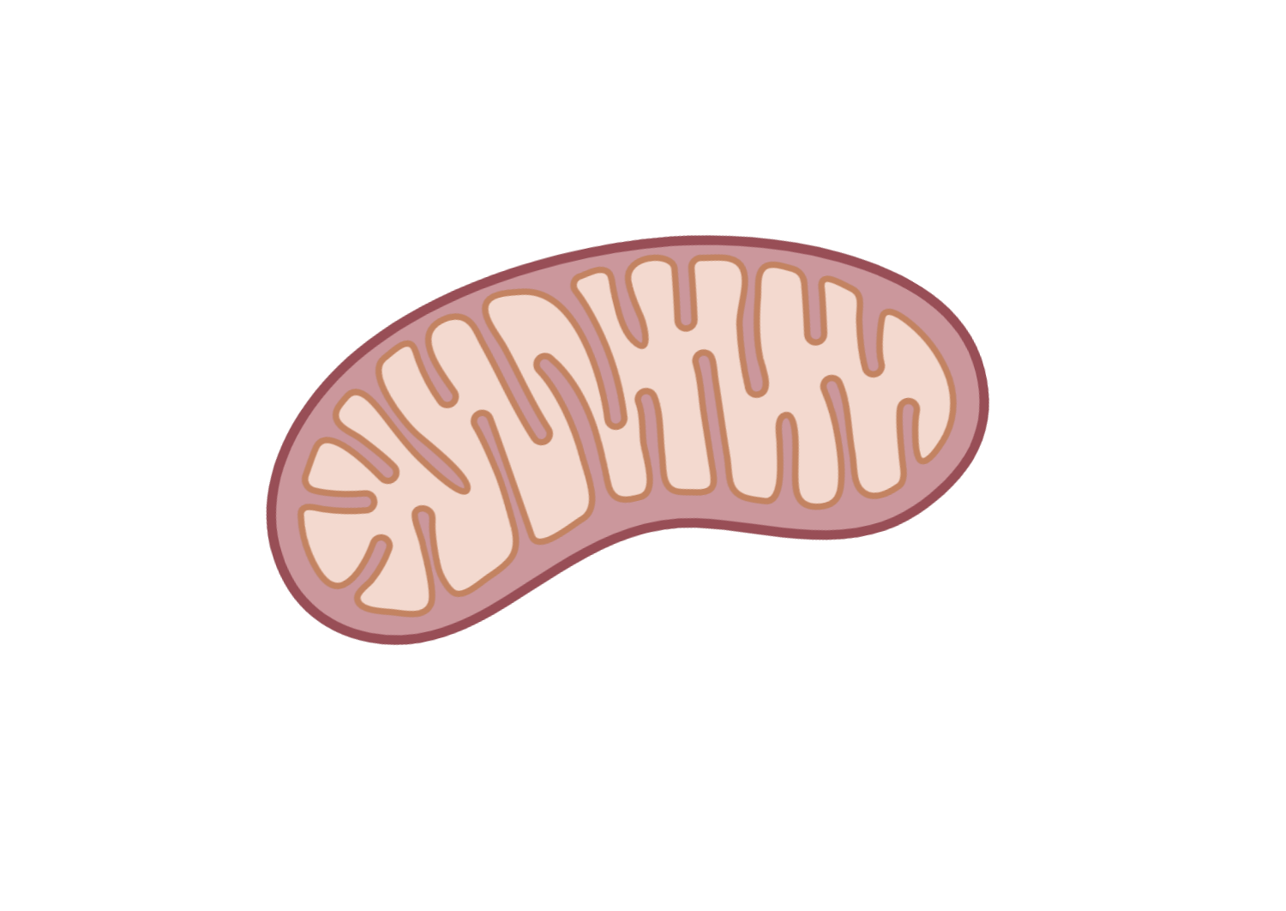
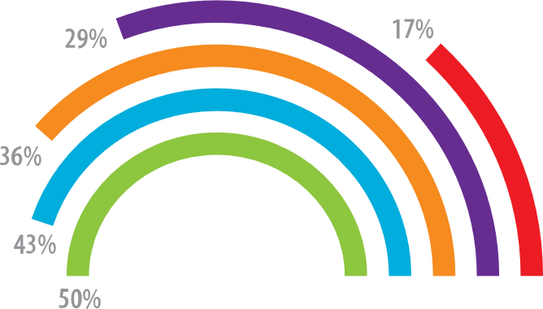
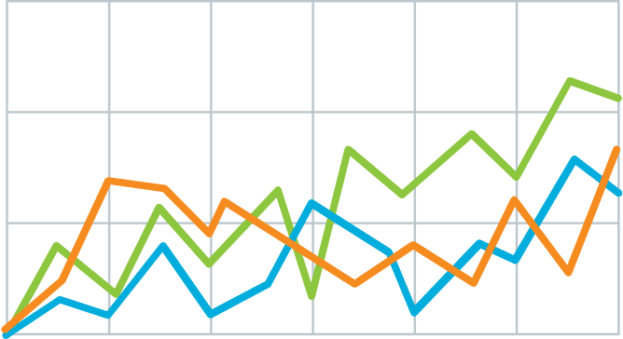
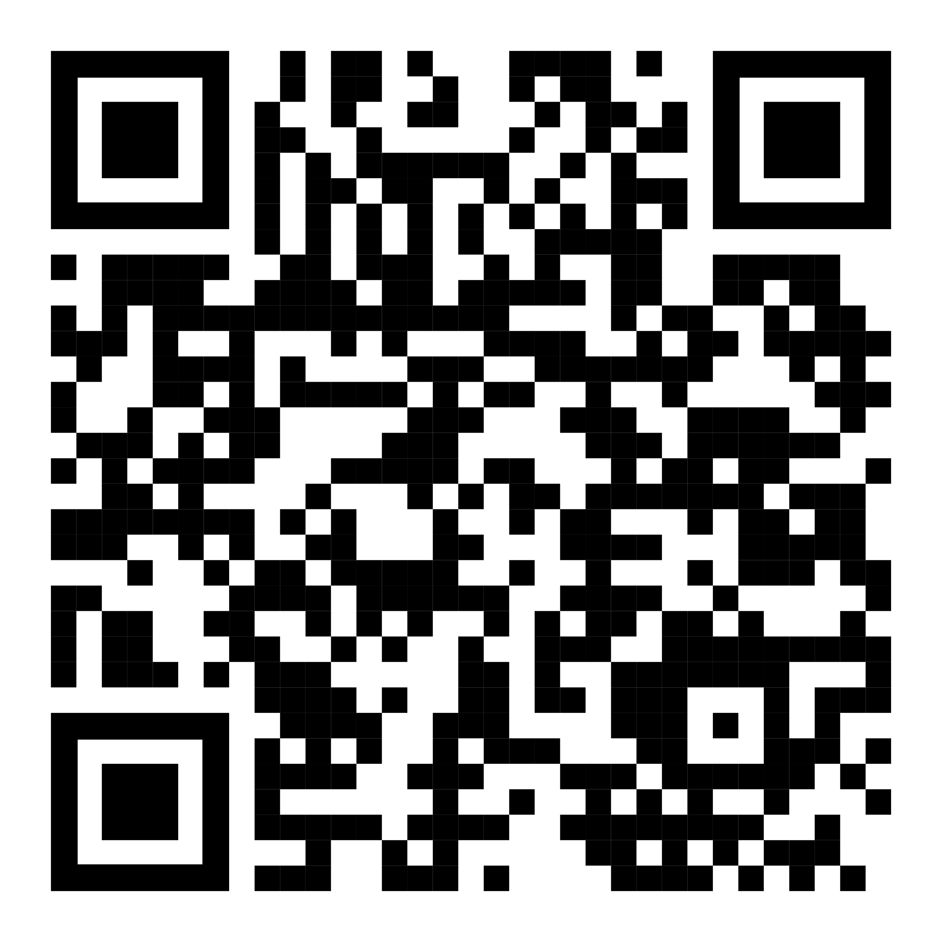
Method
Teach people something cool you learned in 5 seconds as they walk by (or scroll by).
v
Immune checkpoint inhibits T-cell activation.
Anti-PDF-1 antibodies permit T cell activation.
Explain what the graph shows. Like, spoilers are good.
Quickly explain what the graph shows. Help people think.
v
v
(illustrate your takeaway point)
LEM HEWITT, Phillip Merman, Ted crisp EXAMPLE Graphics donated by biorender.com
PrePrint

Slide 3
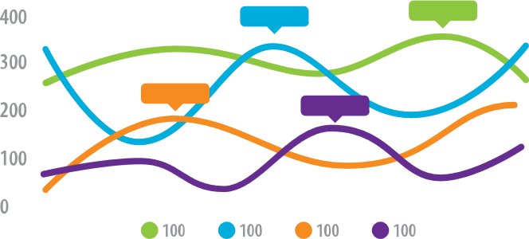
PRESENTER
Lem Hewitt
Teach people something cool you learned in 5 seconds as they walk by.
Background
Who cares? Explain why your study matters in the fastest, most brutal way possible (feel free to add graphics!).
Methods
N=564 Adult full-time workers
EXPERIMENT GROUP
Given iPod Touch’s with a special app that pings them throughout the day with quick surveys.
Wait list (CONTROL GROUP)
Mood Survey (4x per day)
Participants notified by the iPod at random times to take a short mood survey assessing current mood and attention.
End-of-week Survey
Assessed overall performance for the week.
HLM analysis
Used to relate within-person mood to differences in performance.
Extra results
Assume they already read your punchline, and now include a little extra detail.
PrePrint
LEM HEWITT, Phillip Merman, Ted crisp, veronica palmer

Slide 4
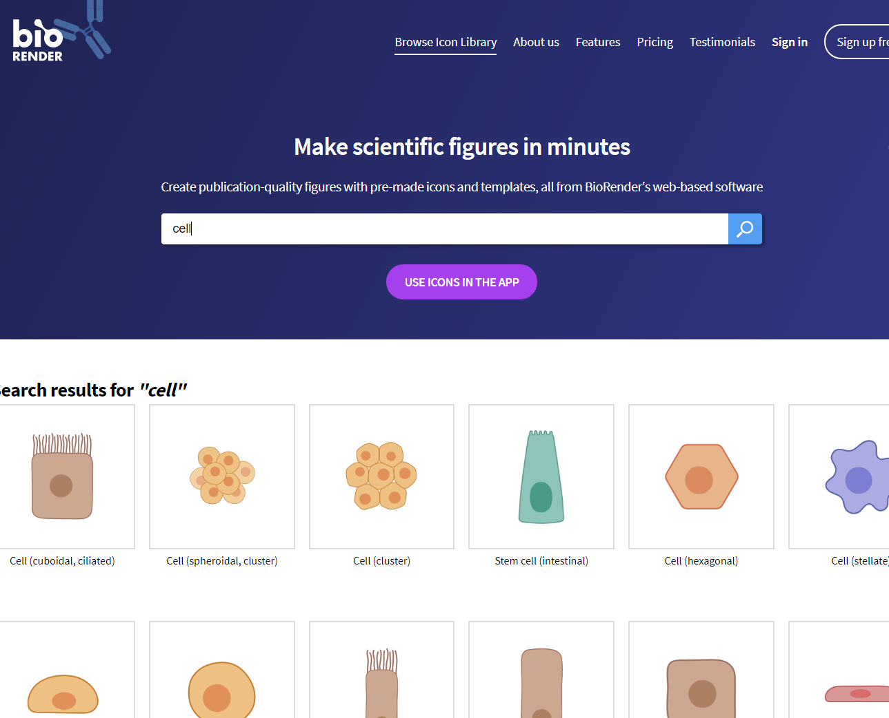
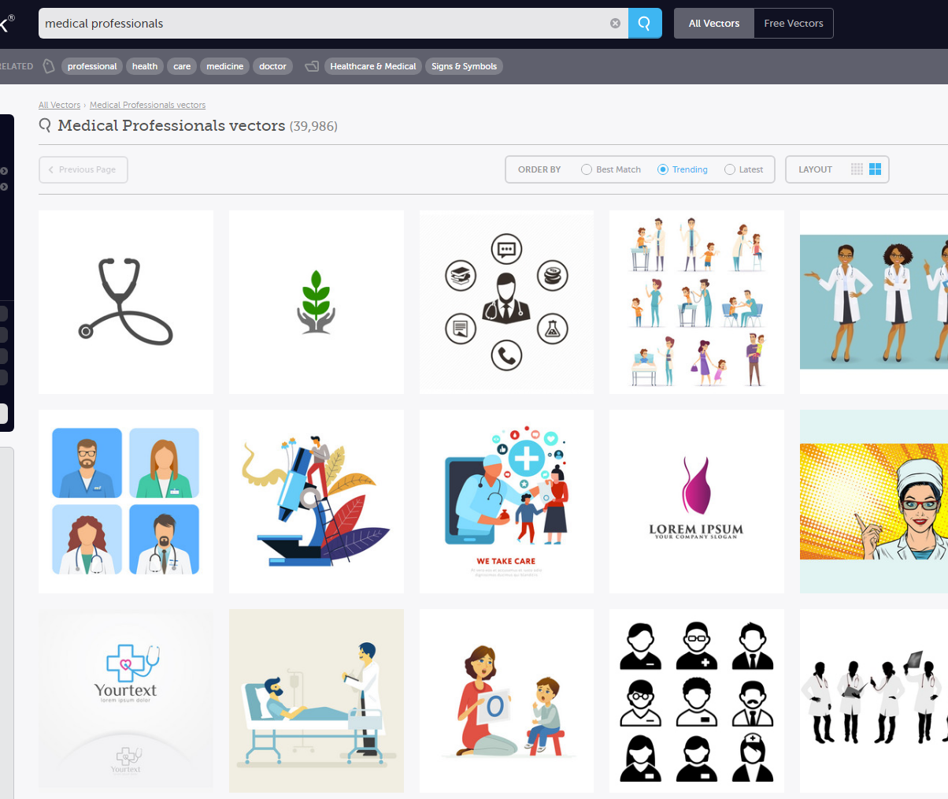
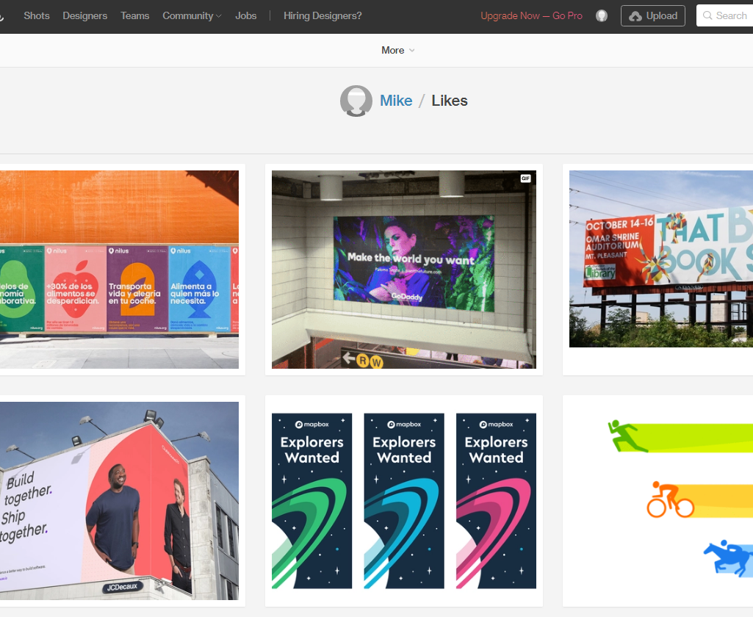
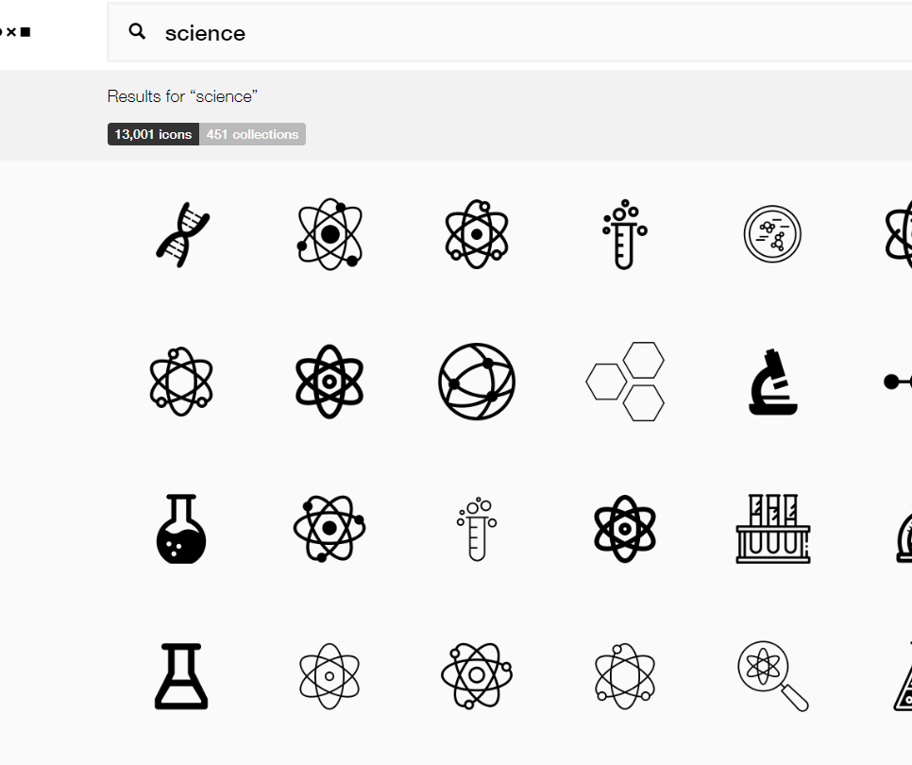
Helpful Design Tools and Resources
You can get free icons from TheNounProject.com
Get full-color graphics on a transparent background for ~$1/each from VectorStock.com
You can create biology figures with BioRender.com
Stuck on a design dilemma? Do what other designers do! Go to dribbble.com and scroll through stuff until a solution jumps out at you. Try searching for “posters” or “graph”.

Slide 5
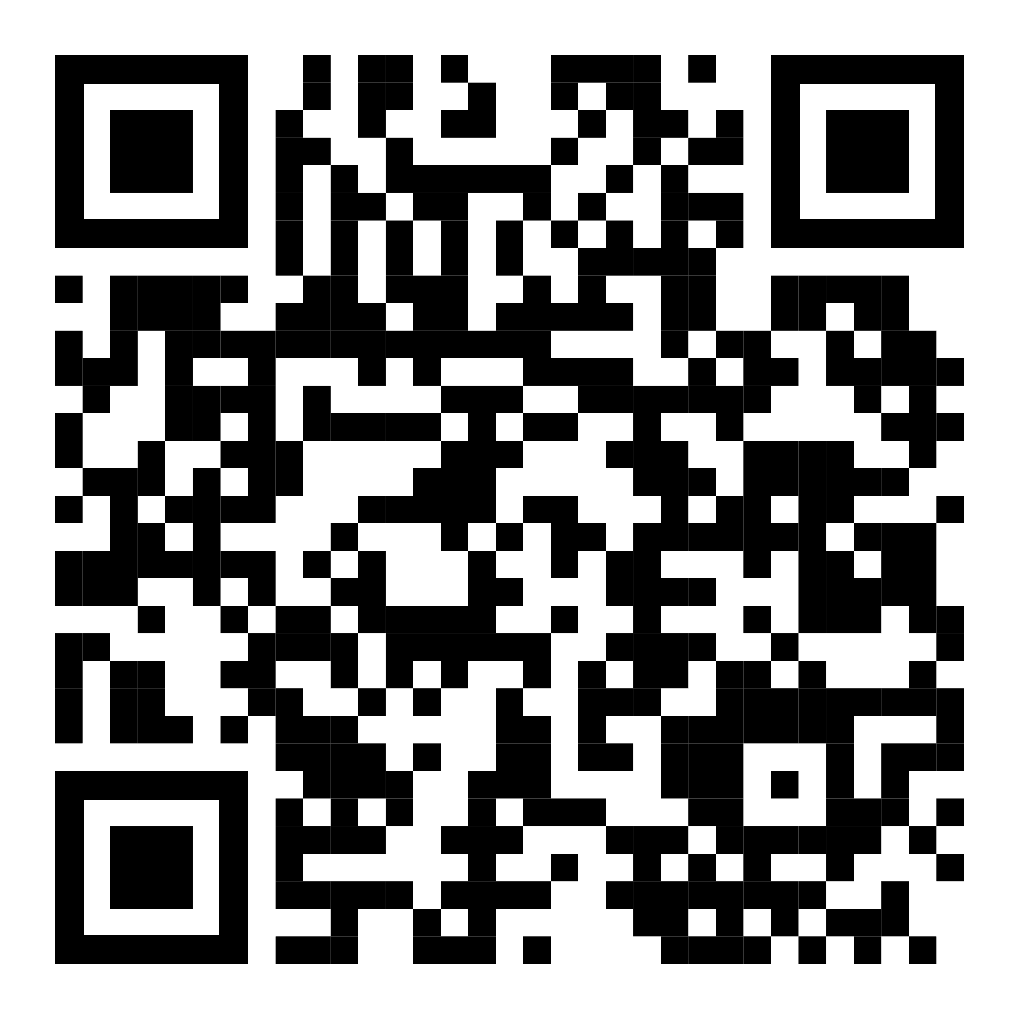
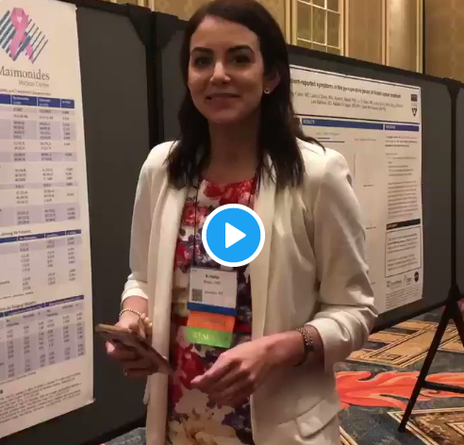
How to QR Code
How do I create a QR code?
https://www.qrcode-monkey.com/ is free, URLs don’t expire, and you can add cool features like images.
How do I scan a QR code?
Just pull out your phone and take a picture! All modern iPhones and most Android phones have built-in QR detection in their cameras. Some Android phones may need an app.
How can I link the QR to my paper and a copy of my poster and my contact details.
Try creating a multi-page link for free via https://linktr.ee/.
Ctrl-click this thumbnail to watch a video on scanning #betterposter QR codes.
Donated by @kristinrojasmd
https://twitter.com/kristinrojasmd/status/1124418213050298368

Slide 6
Research that influenced this design: a.k.a “I need some ammo to help persuade my faculty to try this.”
1. Need to know > Nice to know
https://www.nngroup.com/articles/inverted-pyramid
2. Plain language is interpreted faster.
https://www.nngroup.com/videos/plain-language-for-experts/
https://www.nngroup.com/articles/plain-language-experts/
3. Interaction cost.
https://www.nngroup.com/articles/interaction-cost-definition/
4. Effective designs minimize cognitive load
https://www.nngroup.com/articles/minimize-cognitive-load/

Slide 7
Layout F.A.Q.
What if my intro/methods/results doesn’t fit in the silent bar?
If you’re trying to put so much into that bar that it doesn’t fit, they won’t have time to read it anyway. First try moving stuff to the ammo bar. Next, cut, cut, cut…
Instead of trying to fill space, you’re trying to conserve space.
What if I have a really important graph or picture?
Move the QR Code to the Silent Presenter, then put your graph/image in the middle.

